Slide 1


An Introduction to R Jupyter (Azure) Notebooks
R
by Bryan Cafferky

Slide 2


Slide 3


SQL Saturday in Smithfield, RI December 9th Pre Con: R from A to Z
http://www.sqlsaturday.com/694/EventHome.aspx
Use Discount Code Microsoft
For 20% Off
https://r_programming.eventbrite.com

Slide 4


About Bryan Cafferky…
Microsoft Technical Solutions Enabler
Decades of IT Experience
Microsoft Data Platform MVP
Author of Pro PowerShell for Database Developers
Experienced in health care, insurance, banking, and ecommerce
Founded and lead PASS Chapter The RI Microsoft BI User Group and The SNE R User Group
Proud to be a Nerd.
bryan256@msn.com
www.sql-fy.com
https://www.linkedin.com/in/bryancafferky
@BryanCafferky – follow me!

Slide 5


Time to Find Your Inner Child!

Slide 6
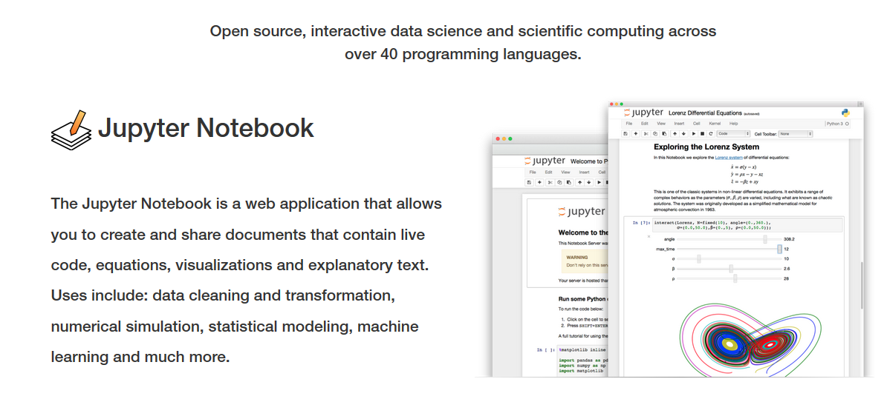
What is Jupyter Notebook?

Slide 7




When to Use Notebooks?
Teaching
Collaboration
Research
Exploration

Slide 8


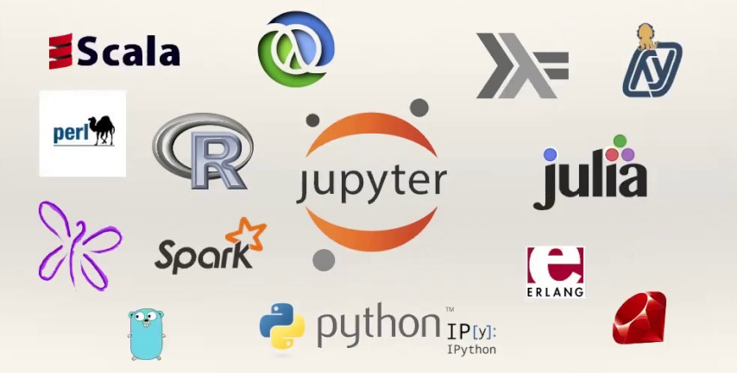

Why Use Notebooks?
75+ Languages Supported
Sharing

Slide 9

Jupyter Notebook
Open Source
Written in Python – originally called IPython
Real time execution and rendering.
Many languages supported.
Supports Spark API (pySpark, SparkR)
Can share via GitHub, JupyterHub, and Azure.
Built-in Viewer Support in GitHub.

Slide 10
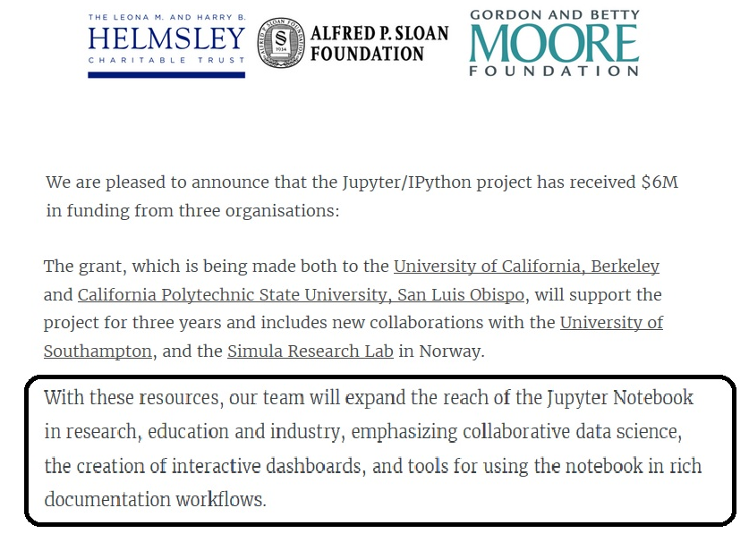
Common Funding = Common Benefit
It’s not just for Python Anymore!

Slide 11
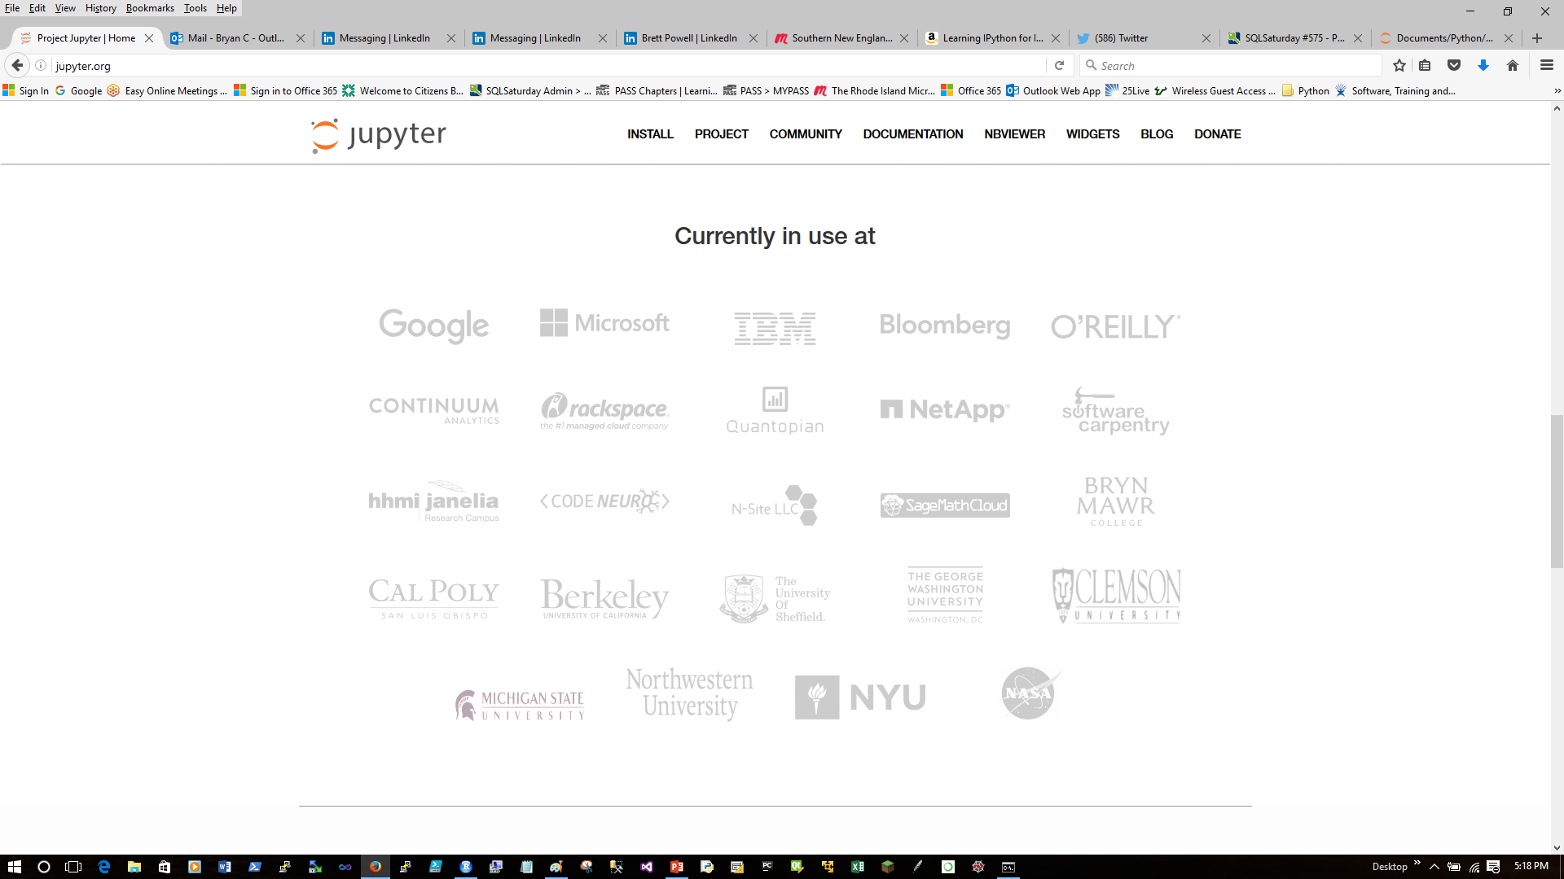
Who uses Jupyter Notebooks?

Slide 12
What’s in a name?
Emphasizes multi-language support.
Jupyter
R
Julia
Python

Slide 13

Why Notebook?
From Galileo’s Notebook –
Drawing’s of Jupiter’s satellites.

Slide 14
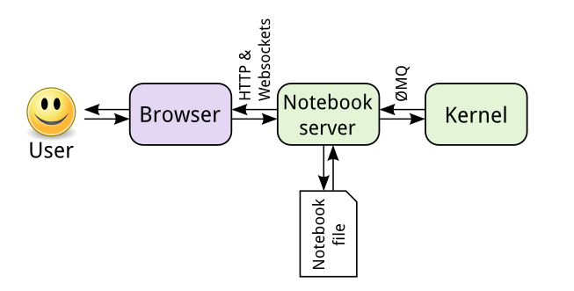
Kernel Architecture
JSON format
Can be many kernels:
Python
R
Julia
Ruby
Perl
PowerShell
http://jupyter.readthedocs.io/en/latest/architecture/how_jupyter_ipython_work.html

Slide 15
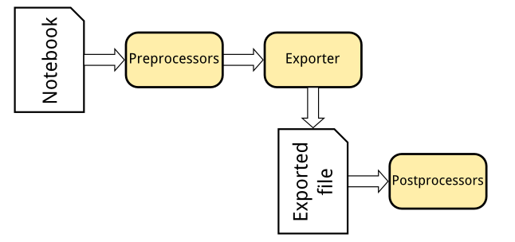
Flexible Notebook Conversions
nbconvert
Formats include:
HTML Slides
PDF
Markdown
Script
http://jupyter.readthedocs.io/en/latest/architecture/how_jupyter_ipython_work.html

Slide 16
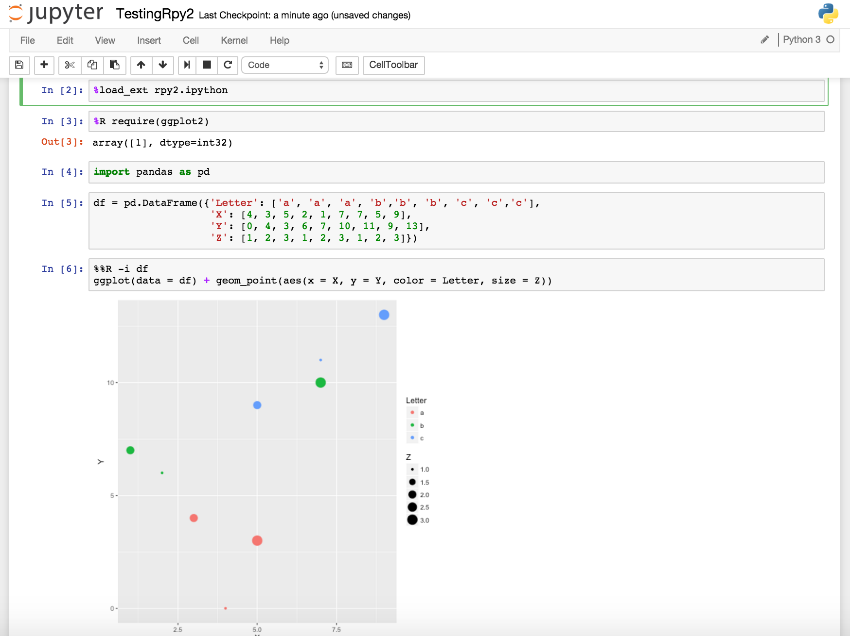
What is Jupyter Notebook?
Execute the cell
Command Prompt called a cell
Code executes in real time.
Can go back, edit and re-run cells.
Like a cross between a command line and Excel spreadsheet.
Rich visualizations rendered inline.

Slide 17
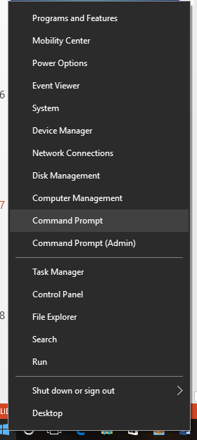
Starting Jupyter Notebook
Start the command shell.

Slide 18
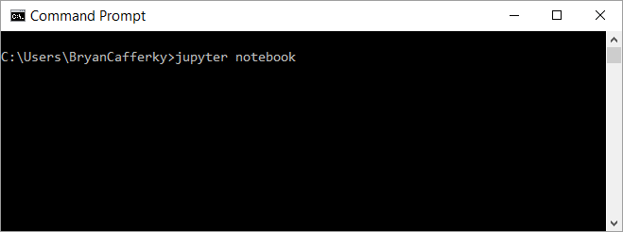
Installing Jupyter Notebook
Start the Jupyter Notebook
Windows Command Prompt
Note: The notebook starts pointing to the folder from where the notebook was started.

Slide 19
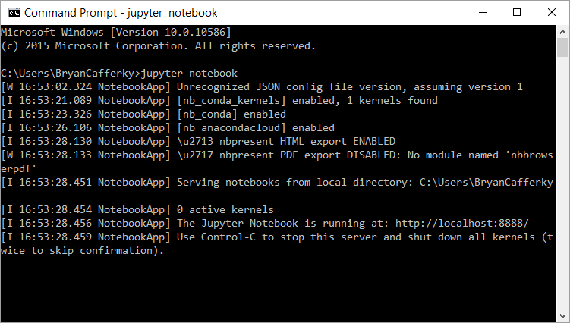
The Jupyter Server Running

Slide 20
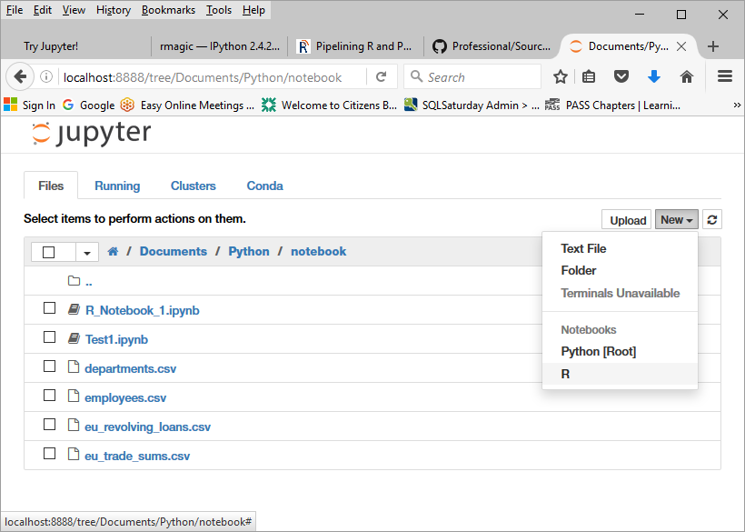
A First Look at a Notebook
Select New and the kernel, i.e. R

Slide 21
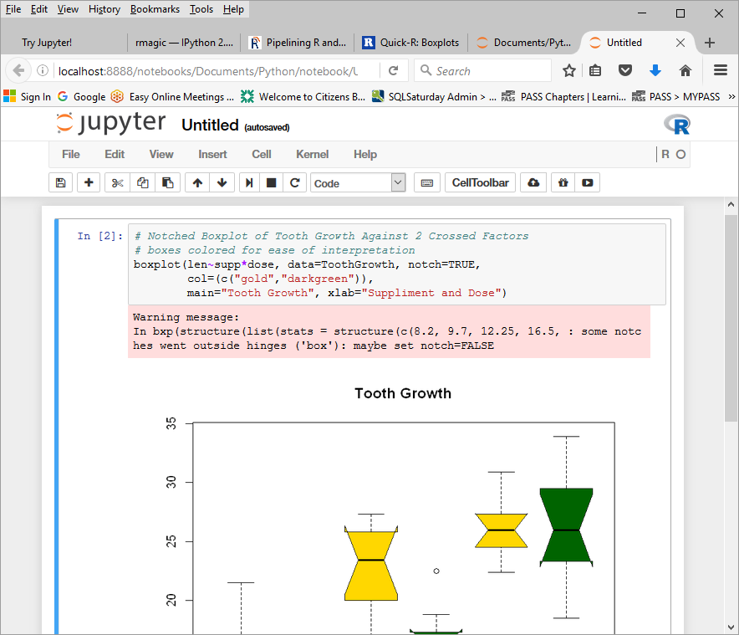
A First Look at a Notebook
Kernel Running
Enter R code and press Shift + Enter
Or
Click on

Slide 22
The Cell Toolbar
Save Notebook
Cut Cell
Copy Cell
Move Cell Down 1
Stop Cell Execution
Insert Cell
Paste Cells Below
Move Cell(s) Up 1
Run Code in Selected Cell(s)
Restart the Kernel
Set Cell Content Type

Slide 23
Exploring Jupyter…
New notebook
Sample notebooks
Python
R
Cell Magic
Widgets

Slide 24
http://jupyter.org/
Documentation
Free notebook play area

Slide 25
Use R and Python Together…
Loads R Python Extension
%R to run R code in the cell
Default language is Python 3
R ggplot call passing data frame, df, from Python
%%R defines data to be passed between R and Python:
-i = Python to R
-o = R to Python

Slide 26
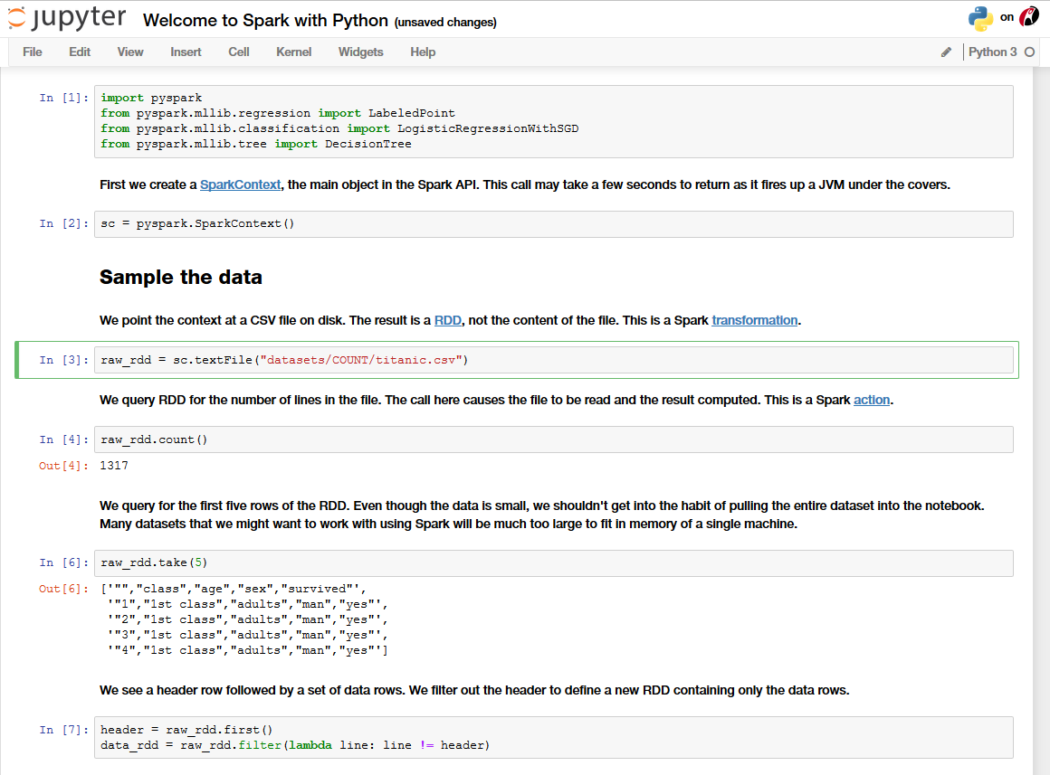
Accessing Spark with pyspark…
Import pyspark module
Set the Spark context
Resilient Distributed Dataset
Point context to HDFS file
Reads the data in Spark
Sample the data

Slide 27
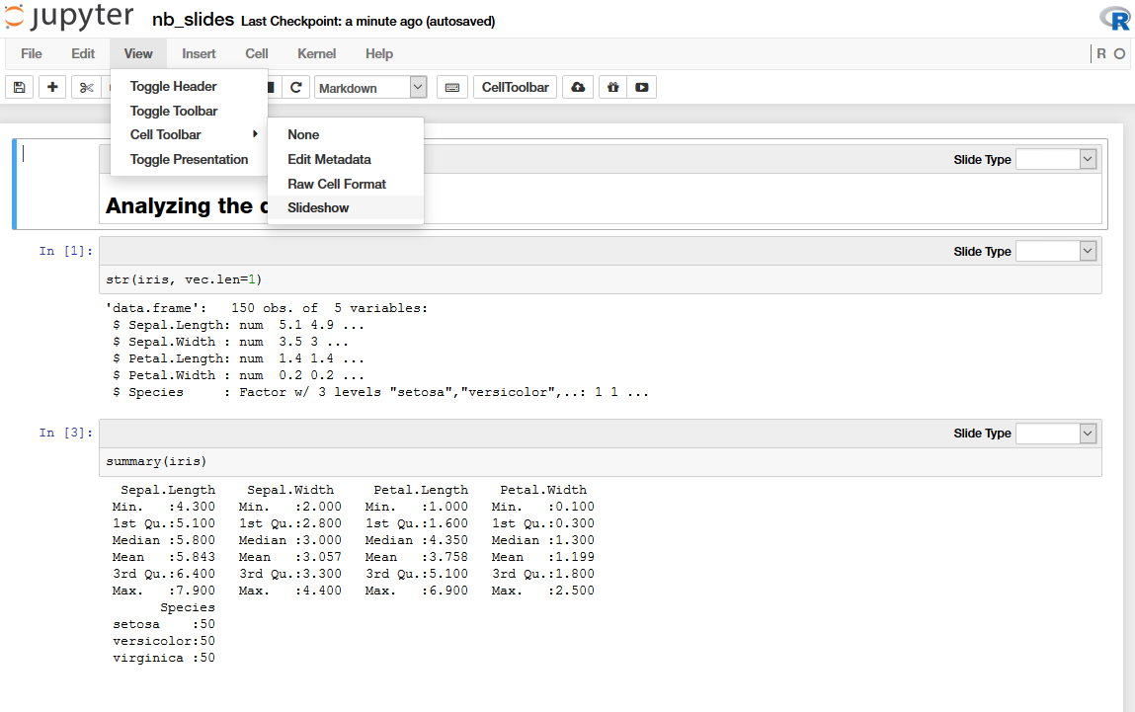
Presentations from Jupyter…
Switch to Slideshow Mode
Organize Slides

Slide 28
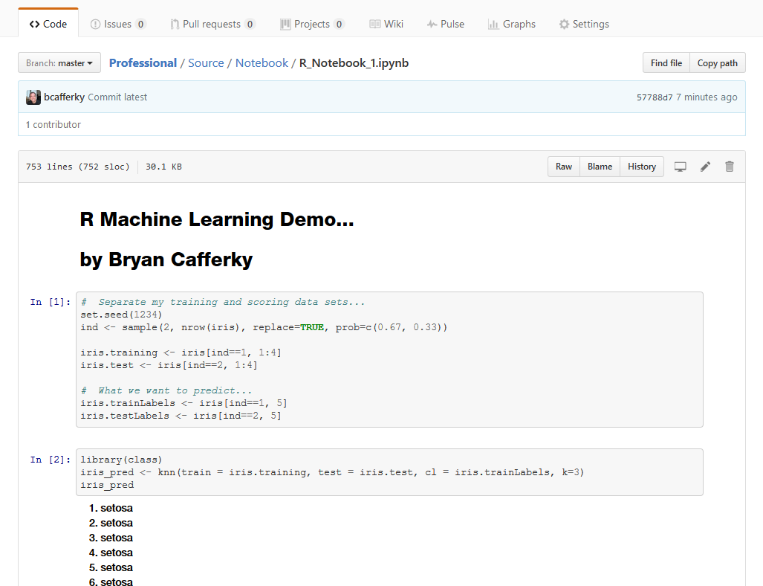
Github Renders Notebooks Automatically…

Slide 29
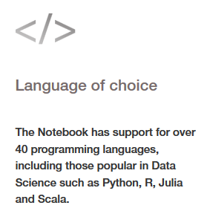
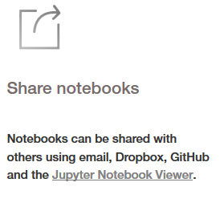
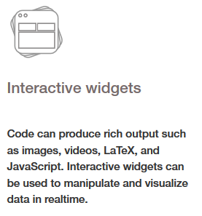
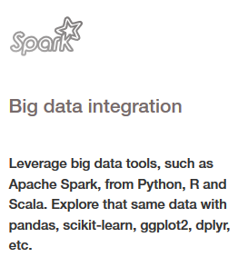
Advanced Data Science Tool

Slide 30
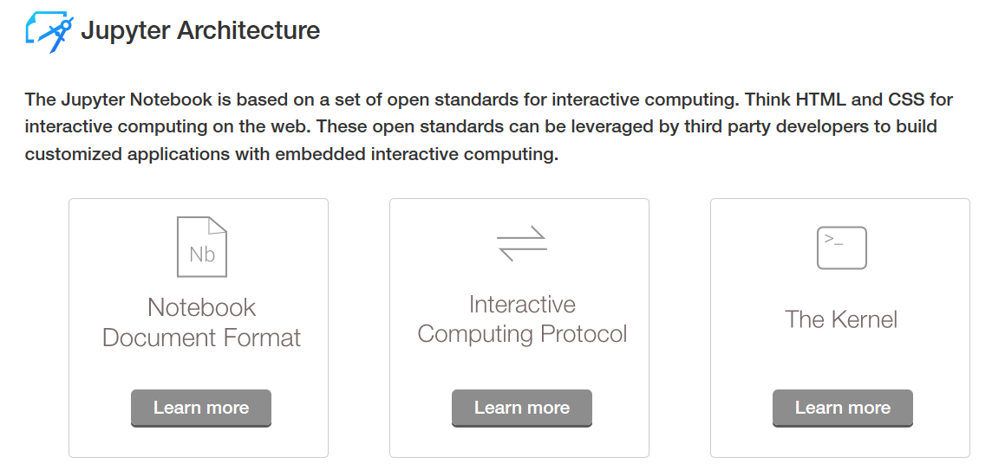
Architecture

Slide 31
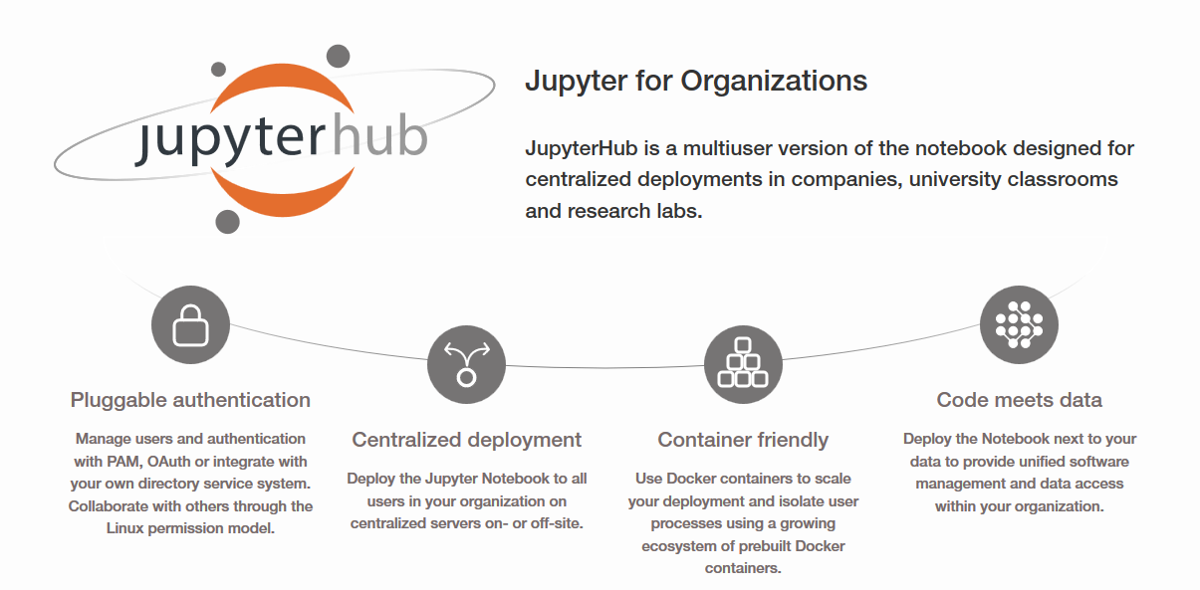
Features

Slide 32

Maximize Notebook Value
https://notebooks.azure.com/

Slide 33
To Install R Packages
install.packages("psych", repo="http://cran.us.r-project.org")

Slide 34
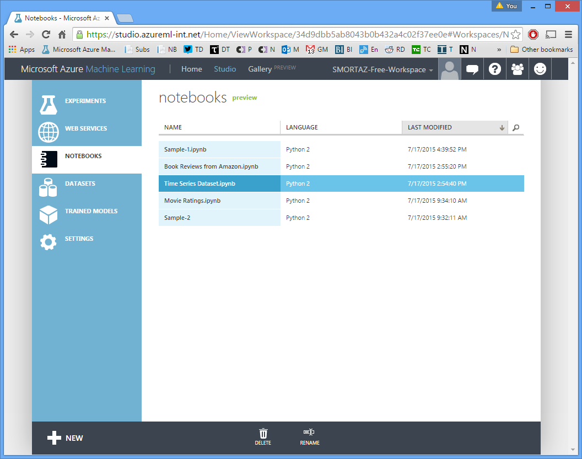
Jupyter Notebooks on Azure
Expand/
Collapse Control

Slide 35
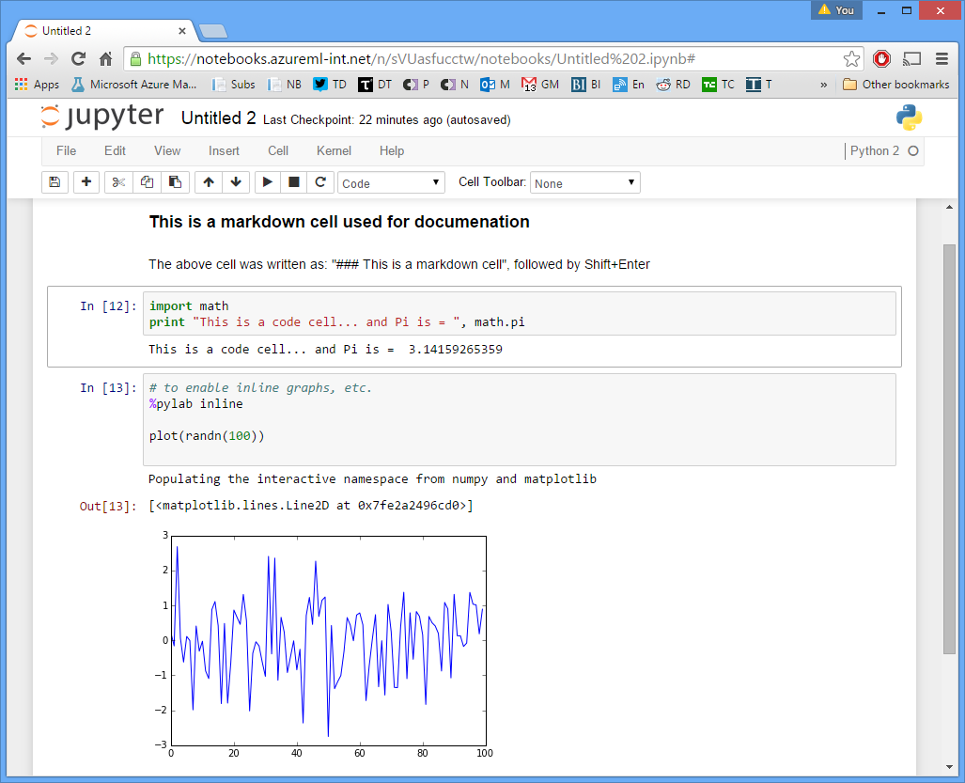
Jupyter Notebooks on Azure
Built-In Support to maintain notebooks.
Share with others.
Initially supports R, Python 2 and Python 3.

Slide 36
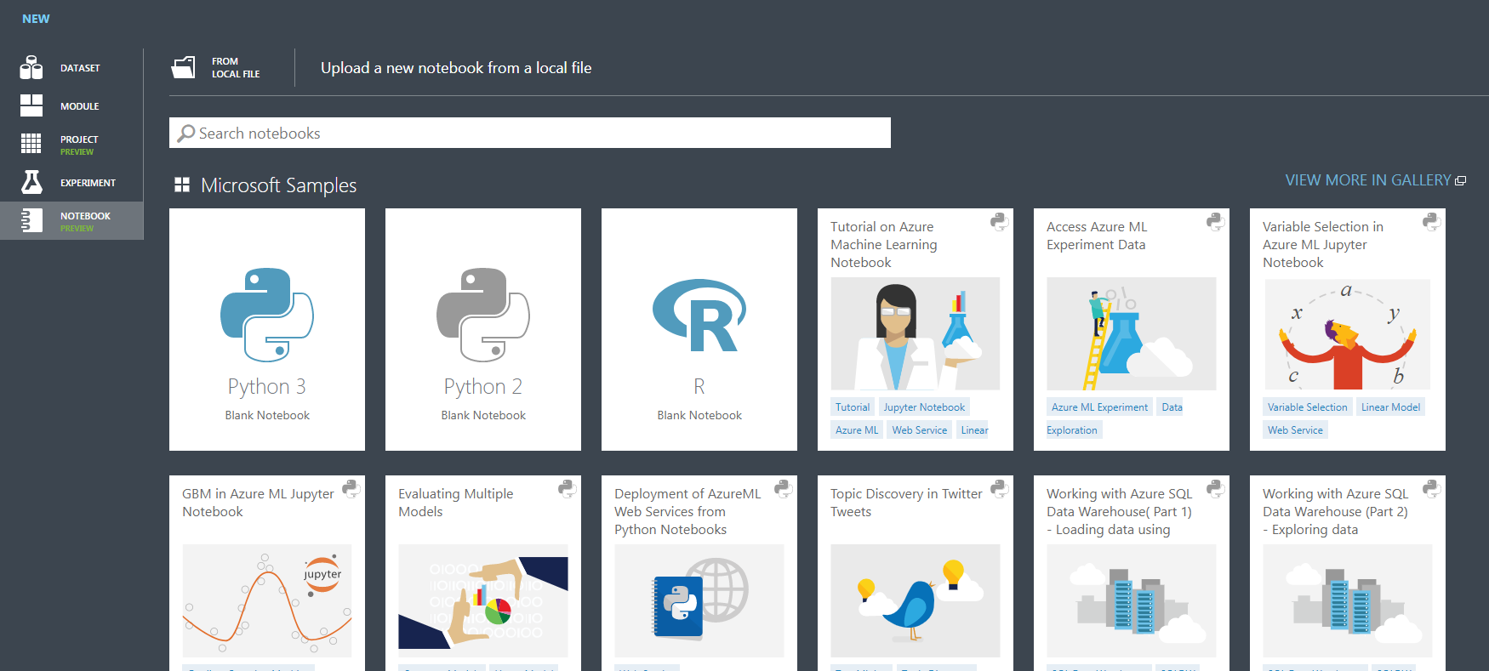
Jupyter Notebooks on Azure
Use the Gallery to Get a Jump Start

Slide 37
Why Azure Notebooks?
Provides Custom Development IDE within the Azure Portal
Notebooks Can Access All Your Azure Resources
Share and Collaborate
Secure
One Tool for Any Language

Slide 38
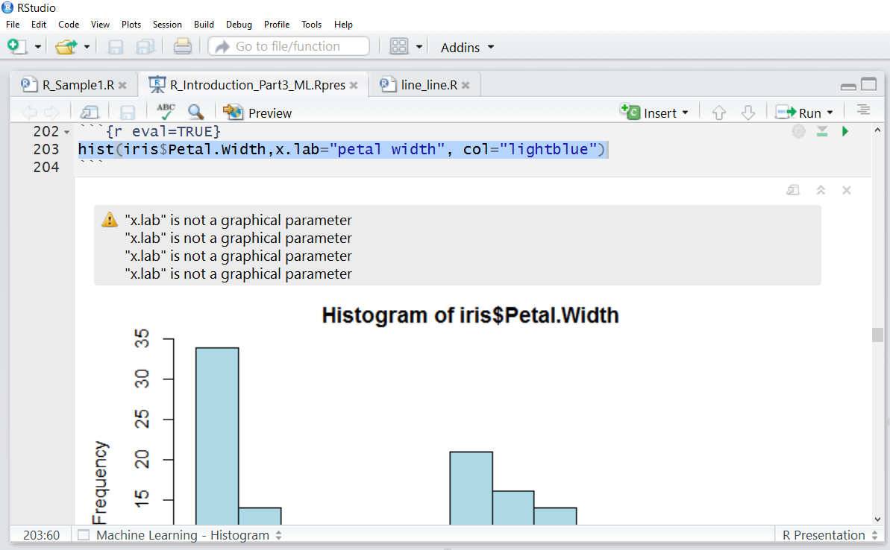
RStudio Fights Back…
Expand/
Collapse Control
Output rendered in the editor

Slide 39
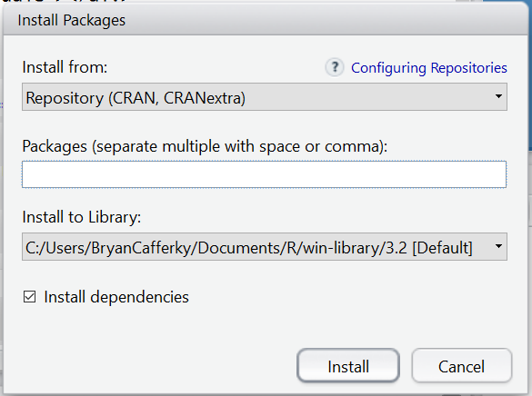
Installing Additional R Packages
Install Pop Up in RStudio
Installing additional R Packages
Find out where R is installing packages.
Find where Anaconda is installed. R packages are in subfolder \R\library
Example: C:\Users\BryanCafferky\Anaconda3\R\library
Copy the package folder from the R folder to the Anaconda folder.

Slide 40
How to get Jupyter Notebook…

Slide 41
Installing Jupyter Notebook
Install Python – Jupyter is a Python application.
Recommend the Anaconda distribution which has many useful packages.
Choose 32 or 64 Bit as appropriate.
Either Python 2.x or Python 3.x will work. Python 3 is the new standard.
https://www.continuum.io/downloads
Install R if you do not have it installed. An R IDE is not required.
https://cran.r-project.org/bin/windows/base/

Slide 42
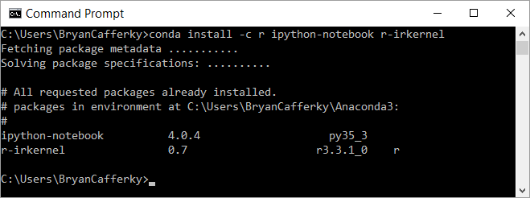
Installing Jupyter Notebook
Install the R Kernel with Extensions, i.e. popular R packages.
Windows Command Prompt

Slide 43
Jupyter Notebook – Wrapping Up
Key Features
Open Source
Written in Python – originally called IPython
Real time execution and rendering
Many languages supported
Supports Spark API
Sharing many ways, i.e. file system, GitHub, JupyterHub, Azure
Built-in Viewer Support in GitHub

Slide 44

Jupyter Notebooks – Wrapping Up
Questions?

